Slide 1

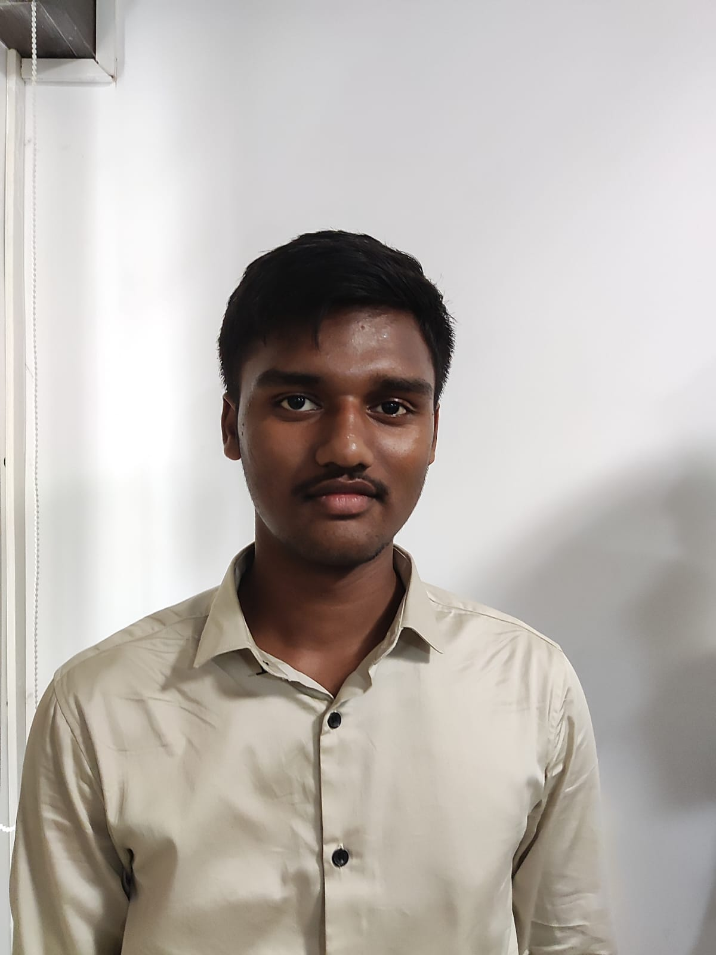
Academic Performance & Career Improvement
Name: TIRUVEEDI NIKHITH
Reg No.: 192224139
Department : AI & DS
Batch : 2022 – 2026
Slot A : Engineering Physics
Slot B : Mathematics -1
Slot C : Python Programming
Slot D : PDSD
Club Name : Publishing Club
Mentor Name : D.Sridhar
Staying : Hosteller

Slide 2

EXAM RESULTS
Slot C | Total Marks | Marks Obtained | Class Average Mark | Attendance
Model Exam B Slot | 100 | 97 | 90 | 100 %
Test 1 ( C Slot) | 100 | NA | NA
Test 2 ( C Slot) | 100 | NA | NA
Test 3 ( C Slot) | 100 | NA | NA
Test 4 ( C Slot) | 100 | NA | NA
Test 5 ( C Slot) | 100 | NA | NA

Slide 3
Conducted Team Meeting on 03.01.2023 (11.00 AM – 12.00 PM)
As per our conversation, your ward is attending in Slot C
Kindly inform your ward,
Coming Tuesday Practical exam will be conducting and Slot D class will be start from Wednesday onwards
This week All days are present in Slot C class
Come to college on time regularly with proper dress code
To maintain above 80% Attendance for all the 4 slots.
Motivate to participate in seminars, webinars, other events at our college / other colleges
Team meeting : Present

Slide 4
MENTEE RESPONSE
PARENT’S RESPONSE
Thank you sir for your kind guidence
Thank you sir for informing about our ward regularly

